Slide 1
Web-based Mixed Synthesis of Planar Four-bar Mechanisms
By
Shashank Sharma

Slide 2
Motivation
Machine designers lack synthesis tools. None of the available packages can synthesize mechanisms well.
Recent reduction in price of manufacturing equipment and control electronics has given, everyone, the power to create. Catalyzed by the maker movement, time is ripe for introduction of a full-fledged machine design package.
A step towards full automation of Machine design process.
Path, Motion and Mixed synthesis capabilities are focused.

Slide 3
Original Contributions
Creation of Web-based platform for Path, Motion and Mixed Synthesis of Planar Four-bar Mechanisms
Proposing optimal parametrization scheme for Path and Mixed synthesis
Development of Mixed Synthesis framework

Slide 4
Fourier based Path Synthesis

Slide 5
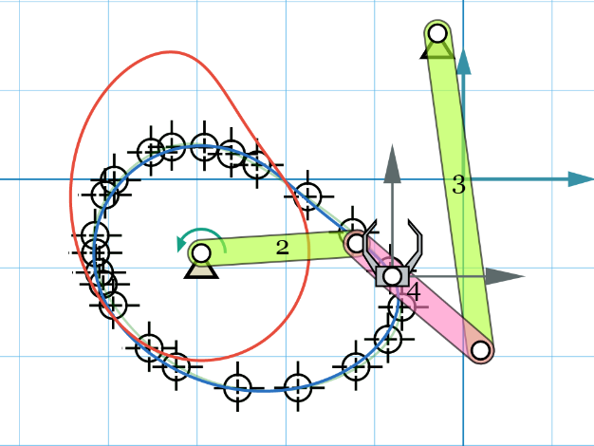
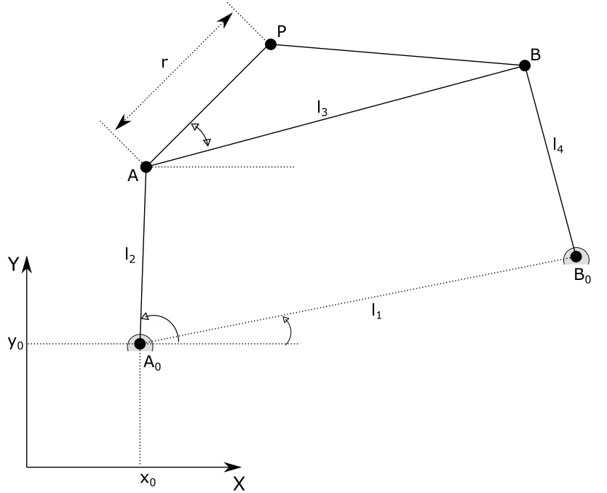
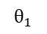
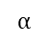
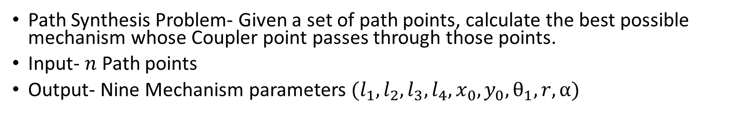
Review: Fourier based Path Synthesis
Path Synthesis Problem- Given a set of path points, calculate the best possible mechanism whose Coupler point passes through those points.
Input- $n$ Path points
Output- Nine Mechanism parameters $(l_{1},l_{2},l_{3},l_{4},x_{0},y_{0}, θ_{1},r,α)$
$$α$$
$$θ_{1}$$

Slide 6
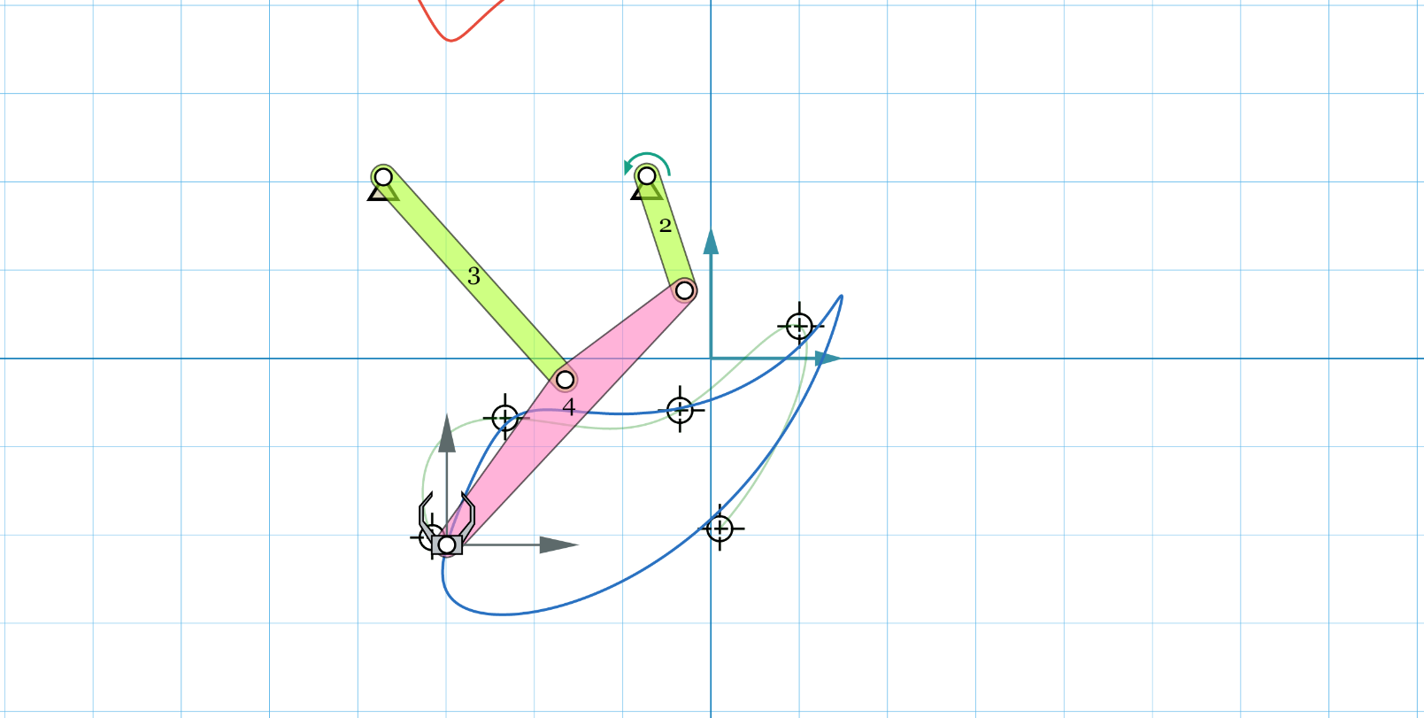
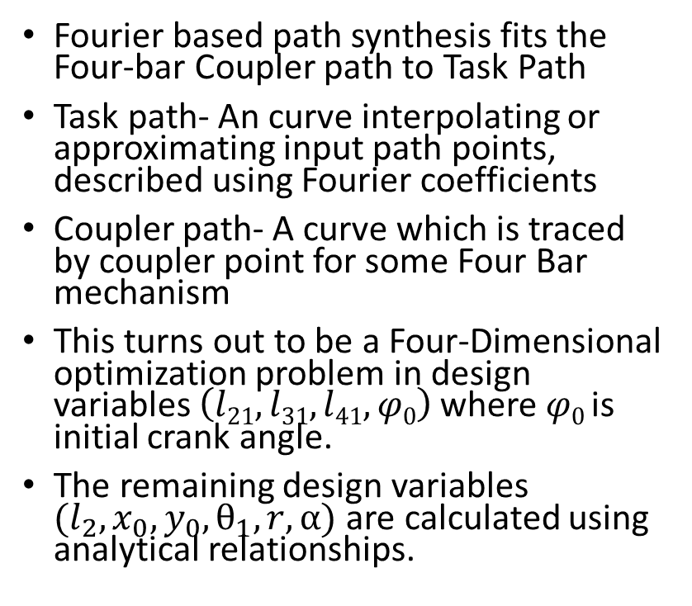
Review: Fourier based Path Synthesis
Fourier based path synthesis fits the Four-bar Coupler path to Task Path
Task path- An curve interpolating or approximating input path points, described using Fourier coefficients
Coupler path- A curve which is traced by coupler point for some Four Bar mechanism
This turns out to be a Four-Dimensional optimization problem in design variables $\left(l21,l31,l41,φ0\right)$ where $φ0$is initial crank angle.
The remaining design variables $(l_{2},x_{0},y_{0}, θ_{1},r,α)$ are calculated using analytical relationships.
Task Path
Four-Bar Coupler Path

Slide 7
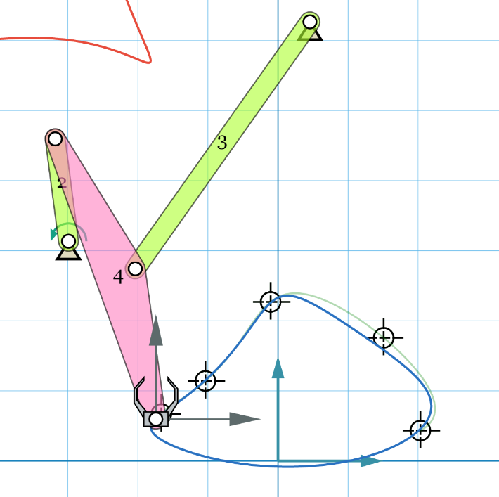
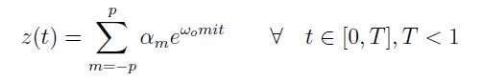
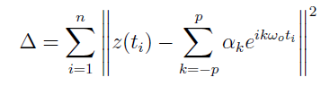
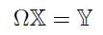
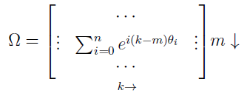
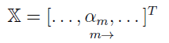
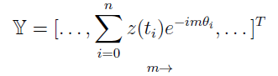
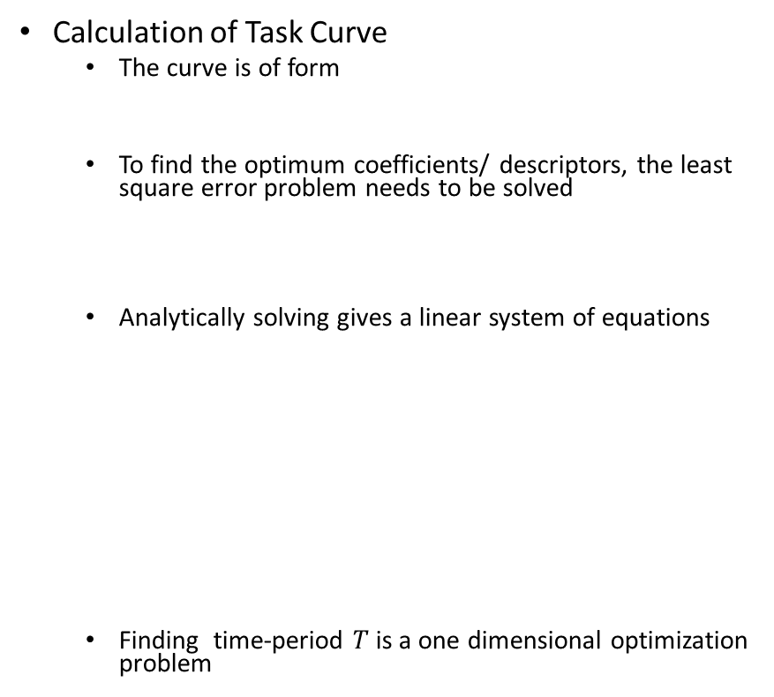
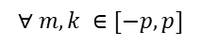
Review: Fourier based Path Synthesis
Calculation of Task Curve
The curve is of form
To find the optimum coefficients/ descriptors, the least square error problem needs to be solved
Analytically solving gives a linear system of equations
Finding time-period $T$ is a one dimensional optimization problem
Task Path
$$∀ m,k ∈[−p,p]$$

Slide 8
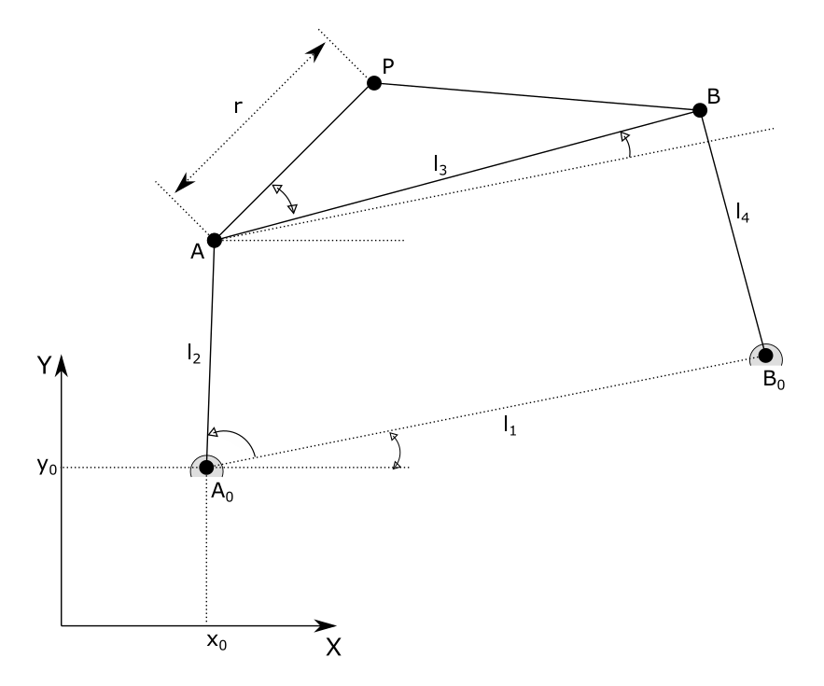
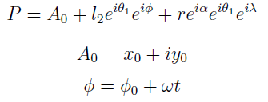
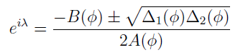
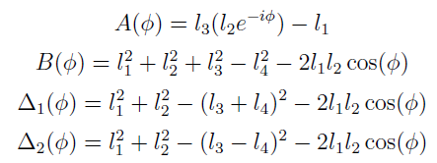
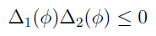
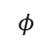
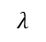
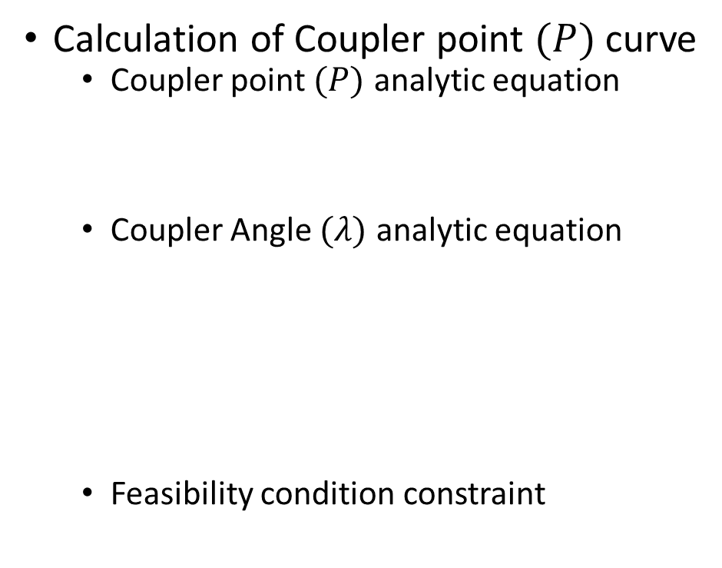
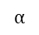
Review: Fourier based Path Synthesis
Calculation of Coupler point $(P)$curve
Coupler point $(P)$ analytic equation
Coupler Angle $(λ)$ analytic equation
Feasibility condition constraint
$$λ$$
$$α$$
$$φ$$
$$θ_{1}$$

Slide 9
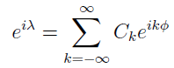
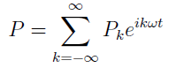
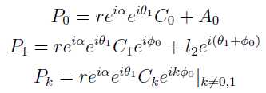
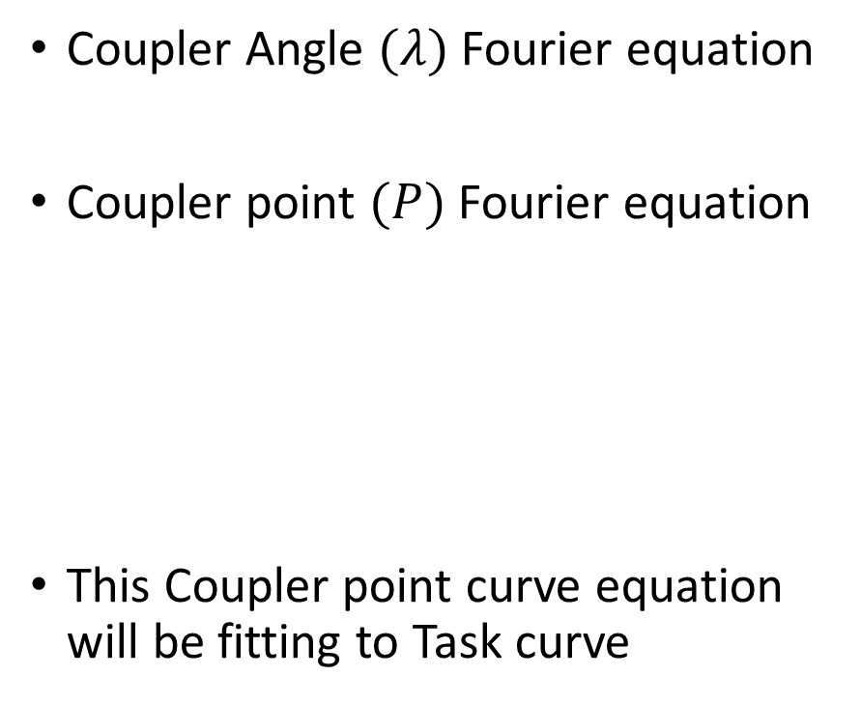
Review: Fourier based Path Synthesis
Coupler Angle $(λ)$ Fourier equation
Coupler point $(P)$ Fourier equation
This Coupler point curve equation will be fitting to Task curve
$$λ$$
$$α$$
$$φ$$
$$θ_{1}$$

Slide 10
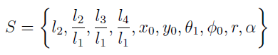
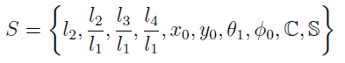
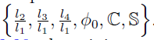
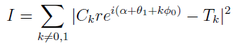
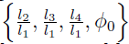
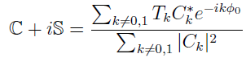
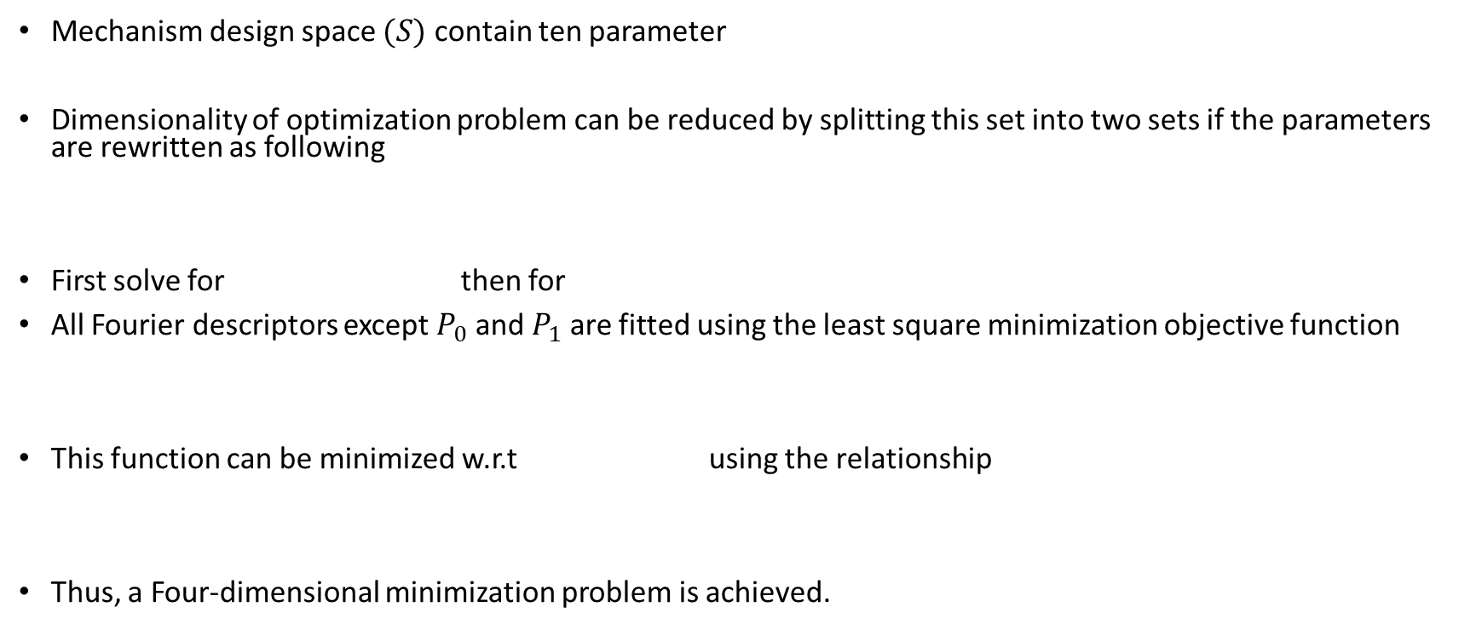
Review: Fourier based Path Synthesis
Mechanism design space $(S)$ contain ten parameter
Dimensionality of optimization problem can be reduced by splitting this set into two sets if the parameters are rewritten as following
First solve for then for
All Fourier descriptors except $P_{0}$ and $P_{1}$ are fitted using the least square minimization objective function
This function can be minimized w.r.t using the relationship
Thus, a Four-dimensional minimization problem is achieved.

Slide 11
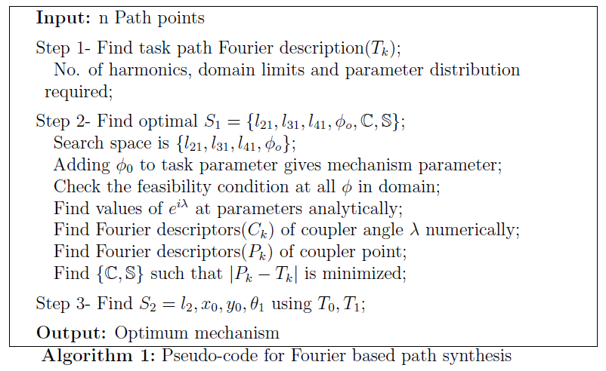
Review: Fourier based Path Synthesis

Slide 12
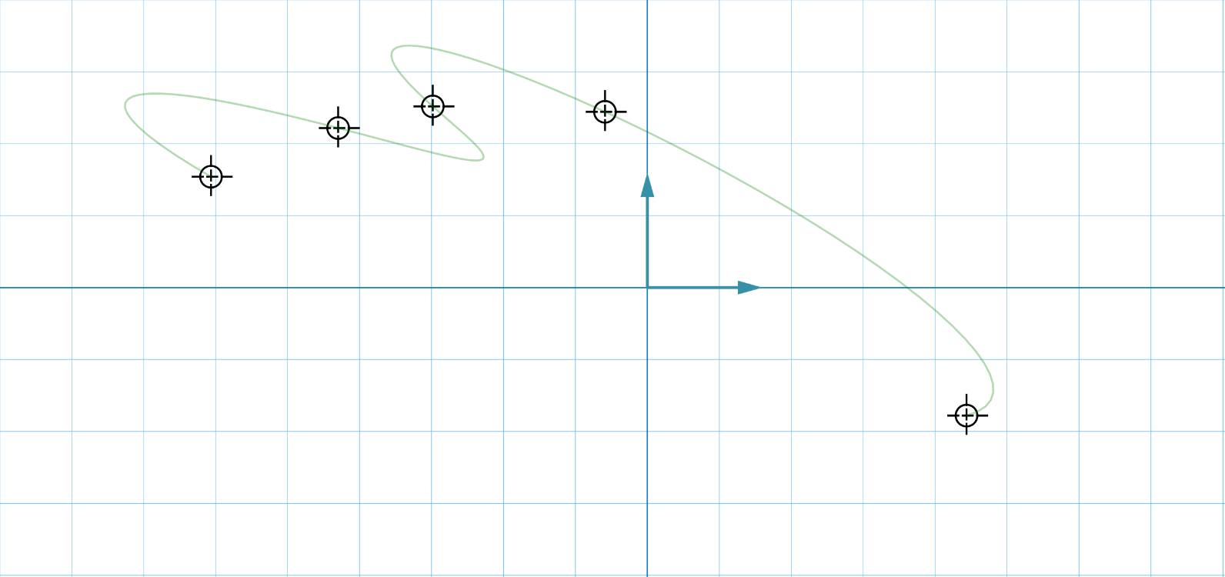
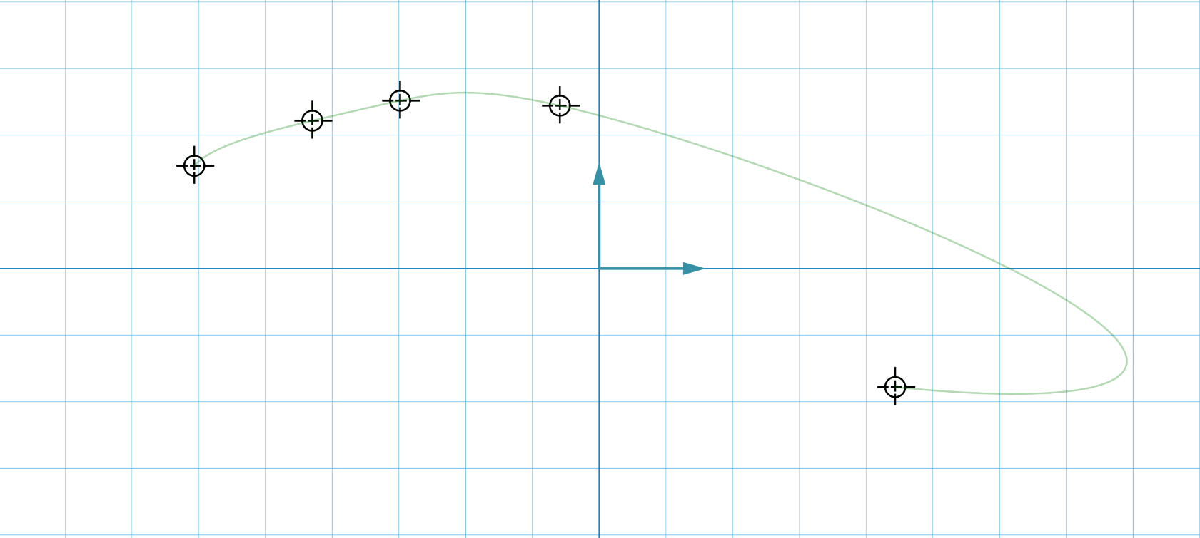
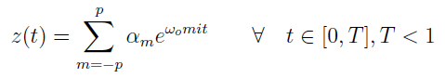
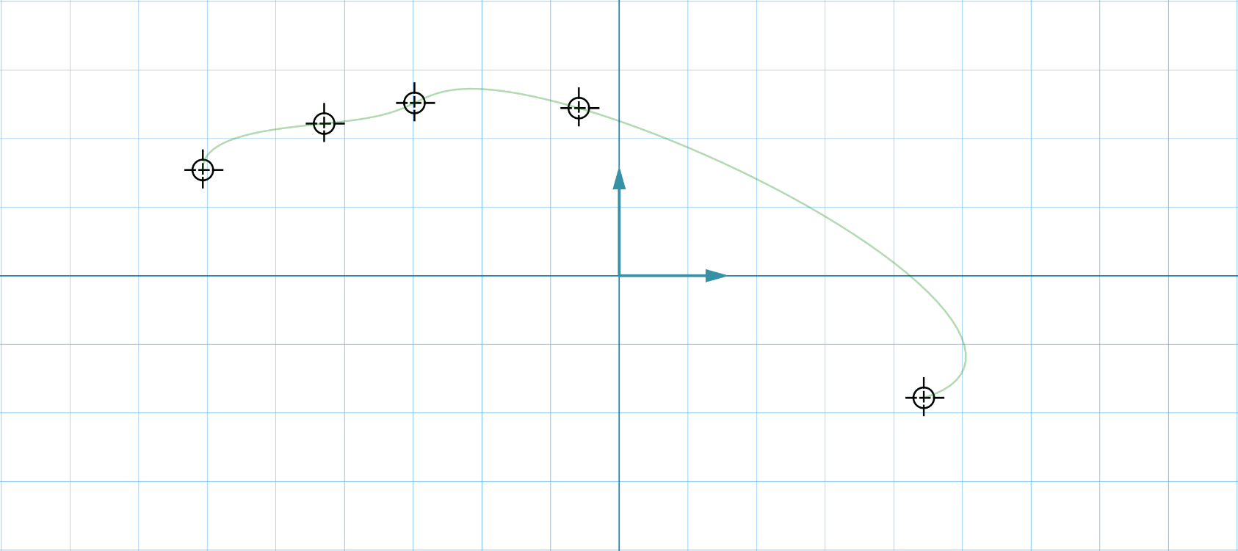
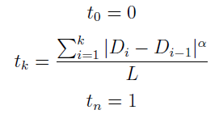
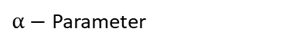
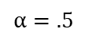
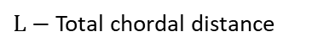
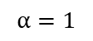
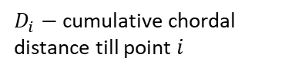
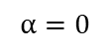
Optimal Fourier Curve fitting
$$α=0$$
In the discussed approach, uniform parameterization of Fourier parameter has been taken. This could result in unintentional task-paths.
We can do better!!
A new family of chord-length based Fourier parameterizations have been proposed where t is defined as
Many new task curves can be described using this parameterization.
$$α=1$$
$D_{i}−$cumulative chordal distance till point $i$
$L−$Total chordal distance
$α−$Parameter
$$α=.5$$

Slide 13
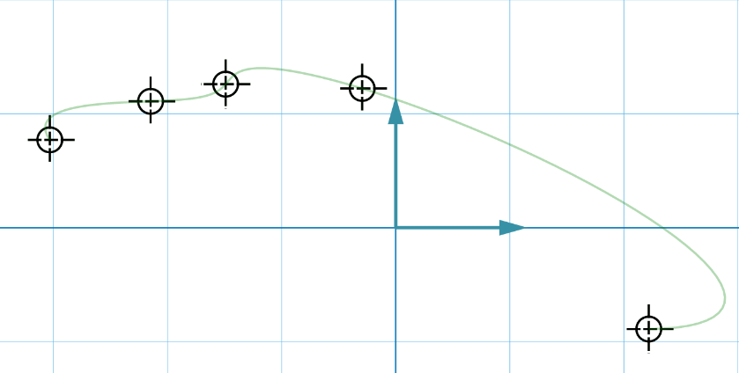
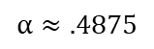
Optimal Fourier Curve fitting
Selection of an optimal Fourier parameterization is done by minimizing total arc length of the curve
The heuristic behind minimum arc length is that smoother curves have lesser arc length. Smoother curves have low high order harmonics. Four bar coupler motion has negligible high order harmonics.
$$α≈.4875$$

Slide 14



Optimal Fourier Curve fitting
A comparison of different mechanisms generated for same input points with different Task curve parameterizations.
$$α=0$$
$$α≈.4875$$
5 path point fitted with a curve having 5 descriptors

Slide 15



Optimal Fourier Curve fitting
$$α=0$$
$$α≈.4687$$
9 path point fitted with a curve having 5 descriptors

Slide 16



Optimal Fourier Curve fitting
$$α=0$$
$$α≈0.875$$
8 path point fitted with a curve having 5 descriptors

Slide 17


Optimal Fourier Curve fitting
9 path point fitted with a curve having 5 descriptors

Slide 18
Optimal Fourier Curve fitting
Observations
When Task curve interpolates the path points, optimal parameterization is very effective. Interpolation curves extremely sensitive to different parameterization.
When Task curve approximates the path points, optimal parameterization is less effective. Approximation curve are less sensitive to different parameterization.

Slide 19






Optimal Fourier Curve fitting- Velocity constraints
Large variation in end effector speeds is usually not the designers intent. The larger the changes in speed, the larger are the forces induced on links which make Dynamic analysis indispensable in these cases. Thus, design-centric velocity constraints would benefit user.
Equations for target path and its velocity are
By sampling points on target curve, maximum to minimum speed ratio $(Sr)$can be calculated.
The designer can bound this Task curve speed ratio between $(S_{r,min})$and $(S_{r,max })$using modified Optimum Parameterization objective function
Here, quadratic penalty function has been used to apply additional velocity constraints

Slide 20
Optimal Fourier Curve fitting
Thus, optimal task curve is calculated using optimal parametrization which is smoothest and follows velocity constraint.
This improves the mechanisms generated by path synthesis.

Slide 21
Frenet Frame based Path Synthesis

Slide 22

Frenet Frame based Path Synthesis
A Frenet frame based path synthesis approach uses motion synthesis algorithms.
Motion synthesis- Given a set of path and orientations, calculate the best possible mechanism whose Coupler point passes through those poses.
Motion synthesis algorithm solve a linear system of equations in quaternion space and thus faster.
Path synthesis algorithm solve nonlinear system of equations in real space and thus slower.
Kinematic mapping based motion Synthesis also does Type synthesis thus including Prismatic and Revolute mechanisms. It can also give multiple solutions.

Slide 23






Review: Kinematic mapping based Motion Synthesis
Map poses to quaternion space
Calculate coefficients of G-manifold using quaternions.
Find the least square solution to the over constrained system of equation $[A]q=0$ using Singular value decomposition. $[A]$ is the G-manifold coefficient matrix. $q$ is the column vector of homogenous coefficients.
Satisfy the C-manifold constraint equations using analytic form of least square minimization
This gives up-to four $q$ vectors which can be converted into dyad parameters

Slide 24
Frenet Frame based Path Synthesis
To convert path problem into motion problem, appropriate orientation data need to be generated for each path point.
Frenet Frame- It is a moving reference frame of orthonormal vectors which are used to describe a time-parametrized curve locally at each point on it.
Frenet Frame can be used to generate orientation data if path point data can be converted into a continuous differentiable curve.
Two types of interpolating/approximation path curves have been used
Fourier curve
B-spline curve

Slide 25


Frenet Frame based Path Synthesis
Both of the curve description perform well for relatively less number of path points.
Since none of the analytical relations between orientation and path for a four bar are being used, it can miss valid mechanisms.

Slide 26
Mixed Synthesis

Slide 27
Motivation
In Frenet frame based path synthesis, the analytical relationship between the orientations and the path has been ignored.
Using this data, better mechanisms would be synthesized.
This relationship is calculated using Fourier based Motion Analysis.

Slide 28









Review: Fourier based Motion Synthesis
Coupler angle $(λ)$ Fourier relation
Coupler point $(P)$ Fourier relation
Coupler orientation $(ζ)$ Fourier relation
Using these equation, a relationship between Path and Orientation can now be calculated
$$δ$$
$$λ$$
$$α$$
$$φ$$
$$θ_{1}$$

Slide 29




Mixed Synthesis
Relationship between Orientations Descriptors and Path Descriptors
Relationship between Orientations and Path Descriptors
For discrete number of poses, the system of equation is
Thus, this equation relates orientation data to Four bar coupler path descriptors.

Slide 30

Mixed Synthesis
Using the optimal Fourier parameterization algorithm, a smooth Task path through the input path points is calculated. This path is used as the approximate coupler path.
Thus, we find “Exact solution to an approximate question”.
The previously developed relationship between orientations and path Descriptors is used to calculate unknown orientations. A least square solution is calculated using SVD for complex system of linear equation.
Once orientations at all path points are known, the Mixed synthesis problem reduces to Motion synthesis problem.

Slide 31

Mixed Synthesis

Slide 32


Mixed Synthesis
Motion Synthesis Constraints (Geometric constraint)- used to specify the position of fixed or moving pivots
Point
Line
Mixed Synthesis Constraints
Actuating fixed pivot $\{x_{0},y_{0}\}$
Coupler parameters $\{r,α,δ\}$
Pure path synthesis- First row
Pure motion synthesis- First column
MOC = Motion Synthesis constraint
MIC = Mixed Synthesis Constraint
FD = Fully Defined
* = Four point Fourier task curve
Green - Implemented in MotionGen2.0

Slide 33

Mixed Synthesis
Comparison of Mixed Synthesis vs Motion Synthesis.
Drastic difference in results!!

Slide 34
Single Degree-of-freedom Coupled Serial Chain Mechanisms

Slide 35

Single Degree-of-freedom Coupled Serial Chain (SDCSC)
Mechanisms that are constructed by mechanically coupling the rotations of the links of an n-link, n-d.o.f. serial chain manipulator using cable and pulley drives or by gear-trains.
Important because it offers simple control of four bar and compactness of serial mechanism.

Slide 36

Path Synthesis of SDCSC
Fit a Fourier task path interpolating/ approximating the given path points.
Select the descriptor count based on the number of links in SDCSC.
Descriptor magnitude and argument denote link length and angle respectively.
SDCSC synthesized for 9 path points having 9 links

Slide 37



Optimal Synthesis of SDCSC
Using optimal parameterization, as in path synthesis, results in a smoother end-effector path.
$$α=0$$
$$α≈.5281$$
SDCSC synthesized for 9 path points having 9 links

Slide 38
MotionGen2.0

Slide 39

Functionality
Green: newly added, Yellow: updated, White: no change)

Slide 40
Competing Softwares
SAM
Path synthesis possible but difficult.
Motion synthesis of four-bar mechanism for 3 precision poses.
Function generation of four-bar mechanism for 3 input-output angle pair.
Exact and approximate straight line mechanisms
GIM
Path synthesis of four bar mechanism for 3,4,5 precision points.
Motion synthesis of four bar mechanism for 3,4 poses.
Function generation of four bar mechanism for 3 input-output angle pair.
Not even close to MotionGen2.0!!

Slide 41
Guiding Principles
Design Paradigm: MVC
Modular coding by recognizing general role of code.
Design Paradigm: RESTful web service
Best practices like URI based resource identification, HTTP CRUD request, stateless server, etc.
Stack selection: MEAN
Full-Javascript based stack for web development.
Mobile App: Apache Cordova
Webview based wrapper application to target multiple platforms using same codebase.
User experience: Response Time Limits
Demarcates limits where user is engaged and when his flow of thought breaks.
User Interface: Responsive web design
Tailored UI for large, medium and small size displays.
User Interface: Principles of display design
UI development guidelines to maximize user efficiency

Slide 42
Back-end Architecture
Frontend- Part of codebase served to the user which resides on his device.
Proxy Server- Handles all requests to the website and proxies them to relevant route.
Static Server- Serves Frontend code on request from website
Computation Server- Processes all computationally tedious tasks which include path, motion and mixed synthesis. Multi-threaded to take advantage of multi-core processing.
Socket Server- Process websocket requests which enable realtime communication between server and client
Redis Server- Used as a central communication between multithreaded cluster on Computation Server and single threaded Socket Server.
Mongodb Server- Database to store the synthesis information being calculated in computation server.
Front- end
Proxy Server
Static Server
Computation Server
Socket Server
Mongodb Server
Redis Server

Slide 43
Back-end technologies
Express- web application framework that provides a simple API to build websites, web apps and backends.
http-proxy- HTTP programmable proxying library that supports websockets.
socket.io- framework which enables real-time bidirectional event-based communication between server and client.
socket.io-redis- run multiple socket.io instances that can all broadcast and emit events to and from each other.
socket.io-emitter- allows communication with socket.io servers easily from non-socket.io processes.
Mongodb- driver API which connects the server to Mongo daemon and database.
Pm2- Production Runtime and Process Manager for Node.js apps with a built-in Load Balancer.
Nodemon- Process manager which works with node cluster module
Fmin- math library used to implement Nelder Mead optimization.
Numeric- math library used to compute SVD of a matrix.
Mathjs- math library used for matrix and complex number manipulation.
body-parser- parses the body content with POST HTTP requests.
http-auth- package which enables client-side authentication requirement
Xmldom- package which enables .xml related functionality
Cordova- framework which repackages the front-end into a mobile app.

Slide 44
Back-end Algorithms
Nelder-Mead
Deterministic local optimization method to solve multidimensional unconstrained optimization
Simulated Annealing
Stochastic global optimization method
Complex SVD
Least square solver for over-constrained system of equations

Slide 45
Front-end technologies
Redesigned streamlined and clutter-free UI

Slide 46
Conclusion
Introduces MotionGen2.0, the first ever web-based scalable application capable of performing Motion, Path, and Mixed Synthesis.
A re-parameterization scheme to optimize Fourier parameters for Path synthesis.
A Fourier based Mixed synthesis approach which unifies Path and Motion Synthesis.

Slide 47
Future Work
Use of trained Neural Network models for faster real-time synthesis.
Use of mixed synthesis to provide a interactive dialog with user and guide them through design process.

Slide 48
Thank You

